Slide 1
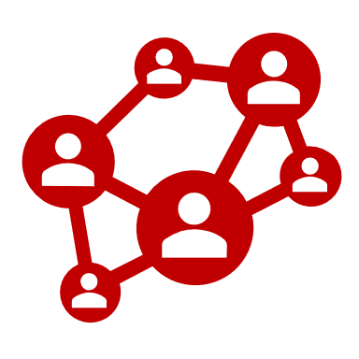
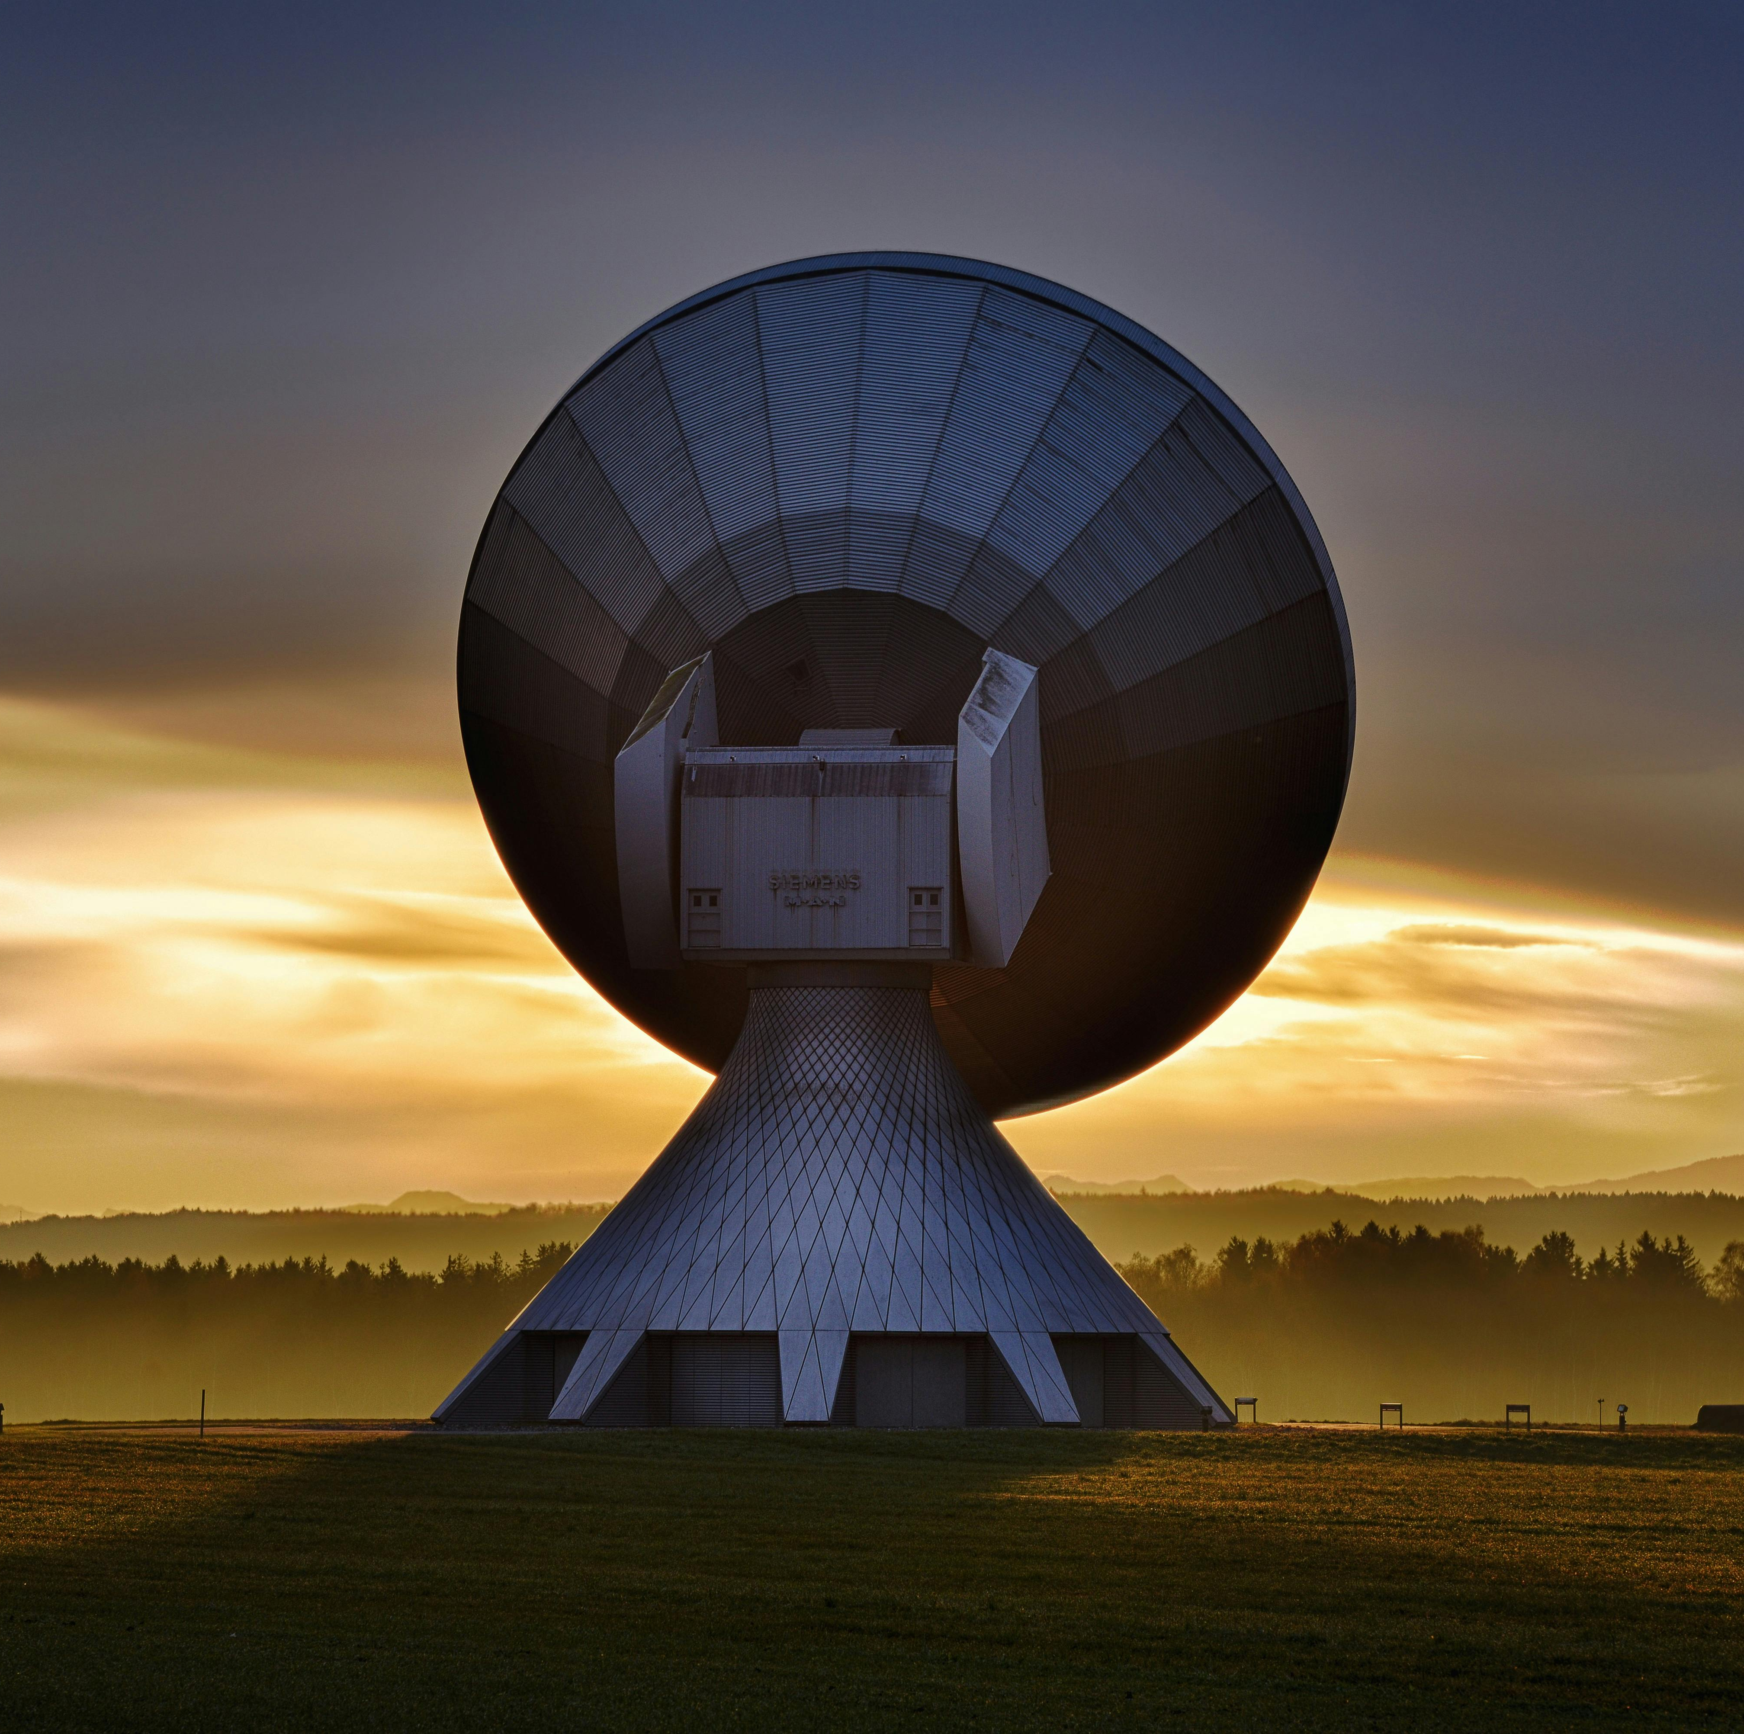
BATCH 2
WIRELESS NETWORKS
2024
March, 2024
Vignan University

Slide 2

ABOUT US
211FA19002 – Y.V. PRANAY KUMAR
211FA19008 – S. VASU VAMSI KRISHNA
211FA19023 – A. BASANTH
211FA19056 – P. SNIKITHA

Slide 3

Reasons for Using Cellular Systems
Cellular systems can accommodate a huge number of users at once. As the need for mobile communication increases, cellular systems can be expanded by adding more cells, providing for continuous coverage and service provision.
01
To make the best use of the available spectrum, cellular networks employ multiplexing techniques such as frequency division multiplexing (FDM) and time division multiplexing (TDM). This enables the transmission of numerous communications over the same frequency range, eliminating the requirement for additional spectrum and hence cutting the cost of deployment.
By dividing the coverage area into smaller cells, cellular systems can provide more reliable service. If a signal is lost in one cell, users can switch to another cell, ensuring continuous communication.
02
Cellular systems are intended to accommodate mobile users. As users move, their devices can automatically switch between cells, ensuring a smooth transition from one to the next.
03

Slide 4
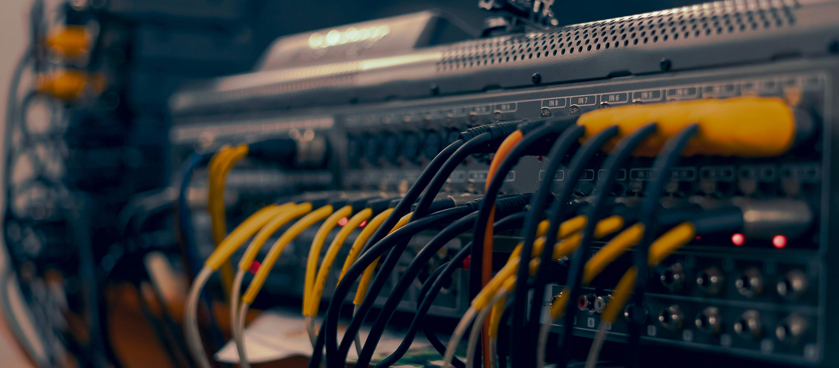
SDM and FDM
This approach divides the available frequency spectrum into several narrow bands, each of which can carry a distinct signal. This enables the simultaneous transmission of numerous signals across the same frequency range, hence enhancing network capacity.
01
SDM is typically realized and combined with Frequency Division Multiplexing (FDM) in the following way :
SDM
FBM
Combination
SDM uses multiple antennas to transmit numerous signals to different users at the same time. Each antenna can transmit a signal to a different user, hence increasing the network's capacity.
02
SDM and FDM can be coupled to boost a network's capacity. For example, each antenna can be utilized to send numerous signals (using FDM) to different users, hence expanding the number of users who can be served at the same time.
03

Slide 5
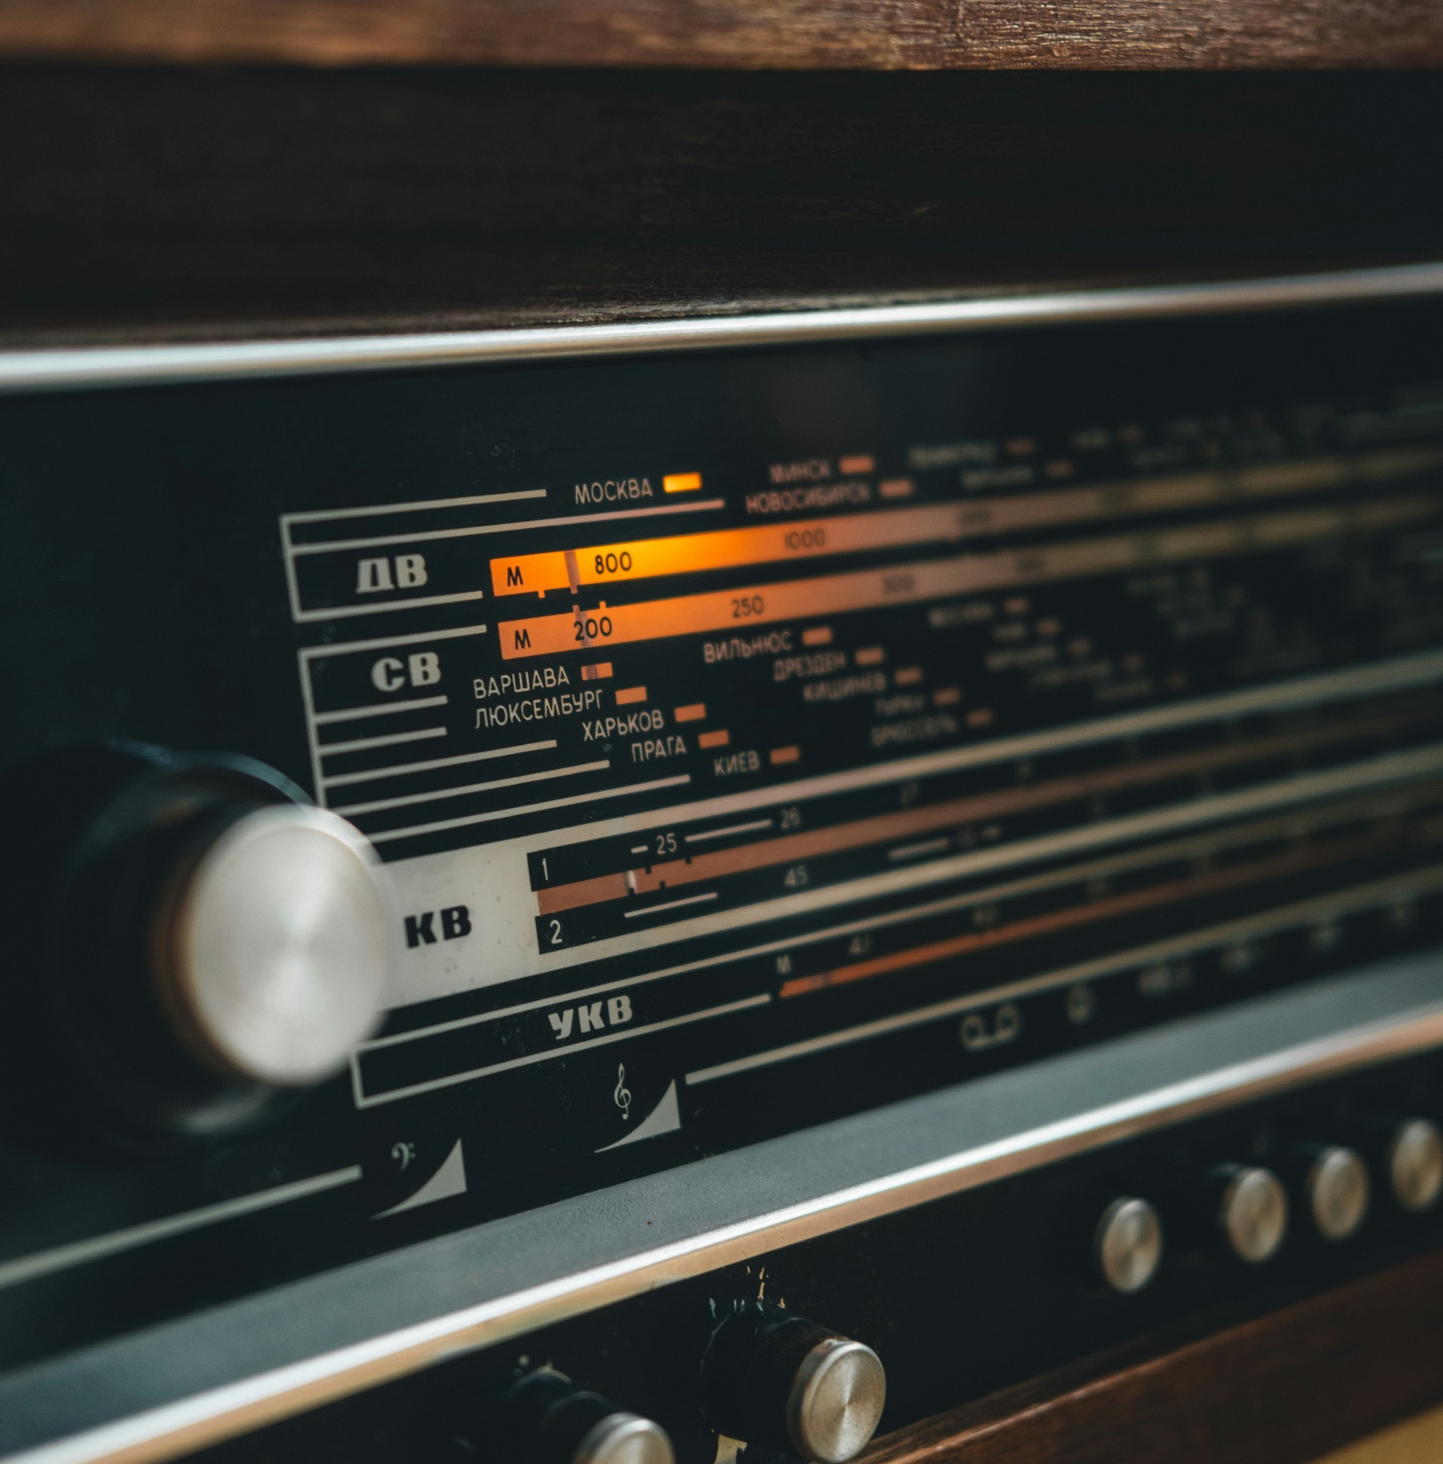
Dynamic Channel Allocation (DCA) and Frequency Availability
Dynamic Channel Allocation (DCA) is a mechanism used in cellular systems to maximize the utilization of available spectrum. DCA modifies the frequencies available in other cells by altering the frequency bands that each cell may access. By dynamically allocating frequencies, DCA guarantees that each cell has access to the frequencies that are most appropriate for its current needs while minimizing interference with other cells.

Slide 6
TDM/FDM Systems
Limitations of TDM/FDM Systems vs. CDM Systems
TDM and FDM systems have a set number of communication channels or slots. This means that the number of concurrent users is determined by the number of channels or slots available. As the number of users grows, the quality of service may suffer due to greater competition for limited resources.
The comparison of Time Division Multiplexing (TDM)/Frequency Division Multiplexing (FDM) and Code Division Multiplexing (CDM) systems exposes a basic capacity difference. TDM/FDM's reliance on preset channels limits user capacity and might impair service as demand increases, but CDM's unique coding for each user overcomes such constraints, enabling scalable and efficient communication solutions.
CDM Systems
Code Division Multiplexing (CDM) systems, on the other hand, can handle an almost infinite number of users because each one is issued a unique code. This provides for far larger capacity than TDM/FDM systems because the number of users has no direct impact on the number of channels or slots.

Slide 7

Interference
Impact of Additional Users on Transmission Quality
Interference becomes more likely when more users transmit signals at the same time. This can lead to signal deterioration and a lower quality of service.
01
When the load in a cell grows, meaning more users are attempting to communicate concurrently, the transmission quality can be altered in a number of ways
Resource Contention
02
Each user competes for finite resources (such as bandwidth and power). This can lead to diminished signal strength and delay.
Quality of Service
03
The quality of service for each user may suffer as the network attempts to manage the increasing demand efficiently.

Slide 8
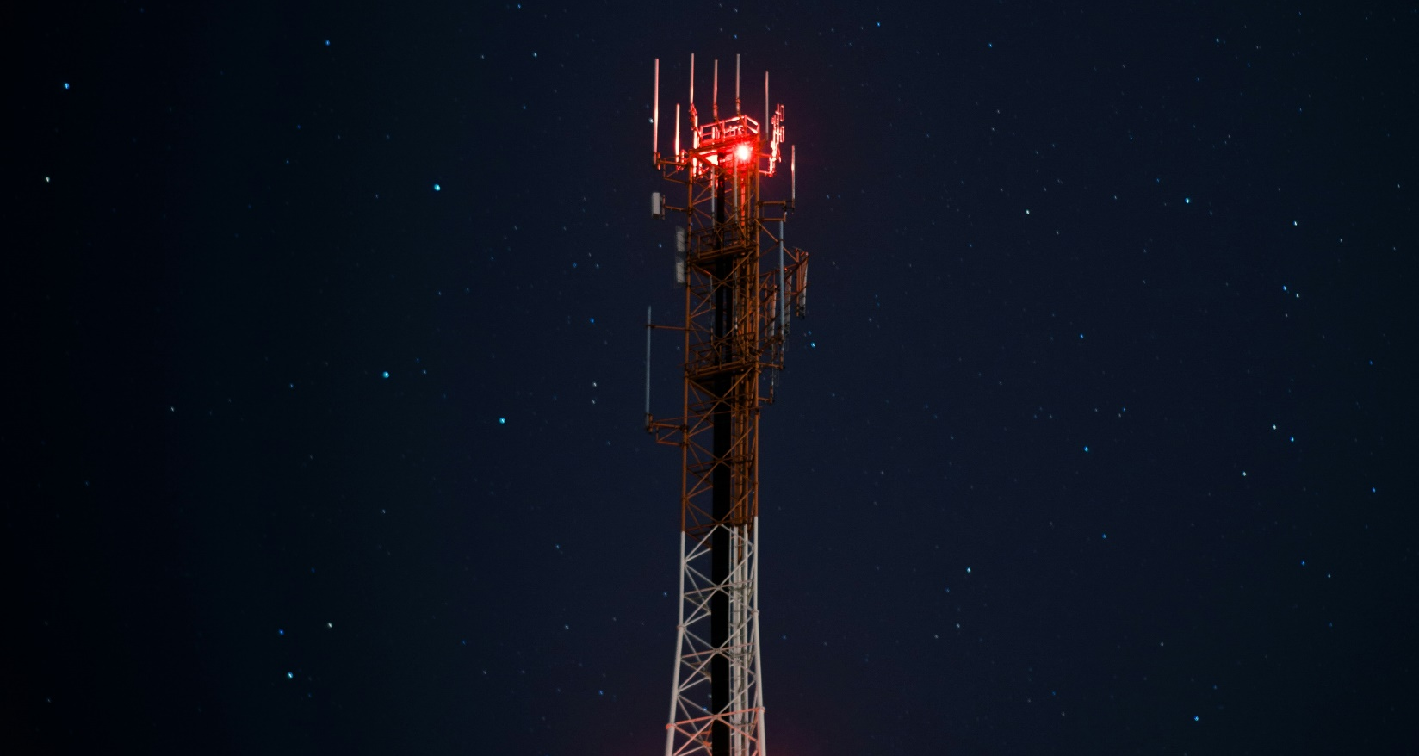
Transmitting Digital Signals Without Loss
Interference
01
External sources of electromagnetic radiation can disrupt the signal, causing it to degrade.
When the load in a cell grows, meaning more users are attempting to communicate concurrently, the transmission quality can be altered in a number of ways
Signal Attenuation
02
As the signal moves through the air, it may lose power owing to absorption, scattering, and other types of attenuation.
Noise
03
Background noise can interfere with the signal, making it harder to discern between the intended signal and the noise.

Slide 9
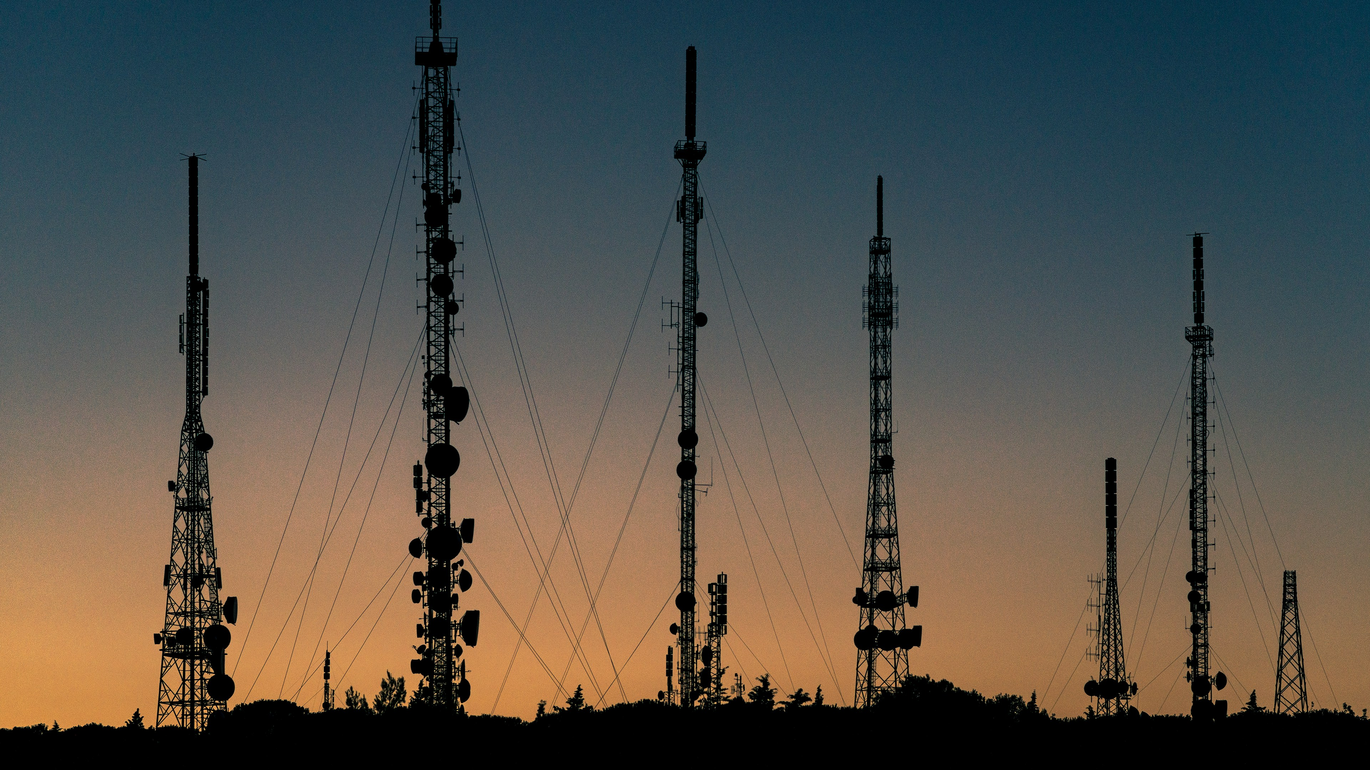
01. Fading
Signal strength can vary over time and distance, leading to a loss of signal quality.
02. Multipath Propagation
Signals can take multiple paths to reach the receiver, with some paths experiencing delays and others causing interference.
Main Problems of Signal Propagation
03. Shadowing
Signal propagation in wireless communication faces several challenges:
Areas where the signal is blocked by obstacles can lead to signal loss or degradation.

Slide 10
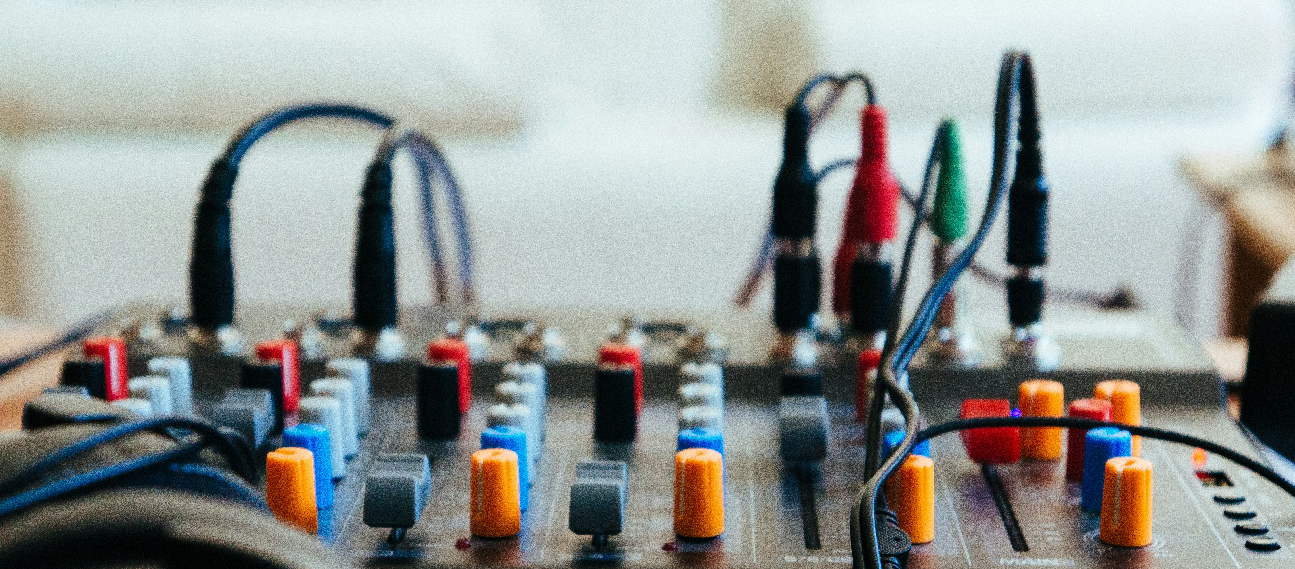
Refraction
Why Radio Waves Don't Always Follow a Straight Line
Radio waves can bend as they pass through different mediums (for example, air and water), causing them to travel along a curved path.
01
Radio waves do not always follow a straight line due to several factors
Diffraction
02
When radio waves approach an impediment, they might spread out and take a curved route.
Scattering
03
Radio waves can be deflected by barriers, leading them to diverge from their intended direction.

Slide 11
Reflection in Signal Propagation
Useful
Reflection can be utilized to broaden the coverage of a signal. A signal can be reflected off buildings or other structures to reach regions that are not directly in line with the transmitter.
Reflection has a dual role in signal propagation, acting as both a friend and foe.
On the one hand, it increases signal reach by reflecting off surfaces.
On the other hand, it can cause interference because reflected signals may collide with direct signals at the receiver.
Harmful
Reflection can also result in interference. If a signal is reflected off an obstruction and reaches the receiver, it may interfere with the direct signal, resulting in signal deterioration.

Slide 12


Thank You
BATCH 2
CYBER SECURITY
III ACSE

